Slide 1
1st Project: Regression
by Silas Mederer
at neue fische GmbH

Slide 2
What you can expect
Overviewing data
Client descriptions and request
Regression models
Linear regression with bad results
Future projects

Slide 3
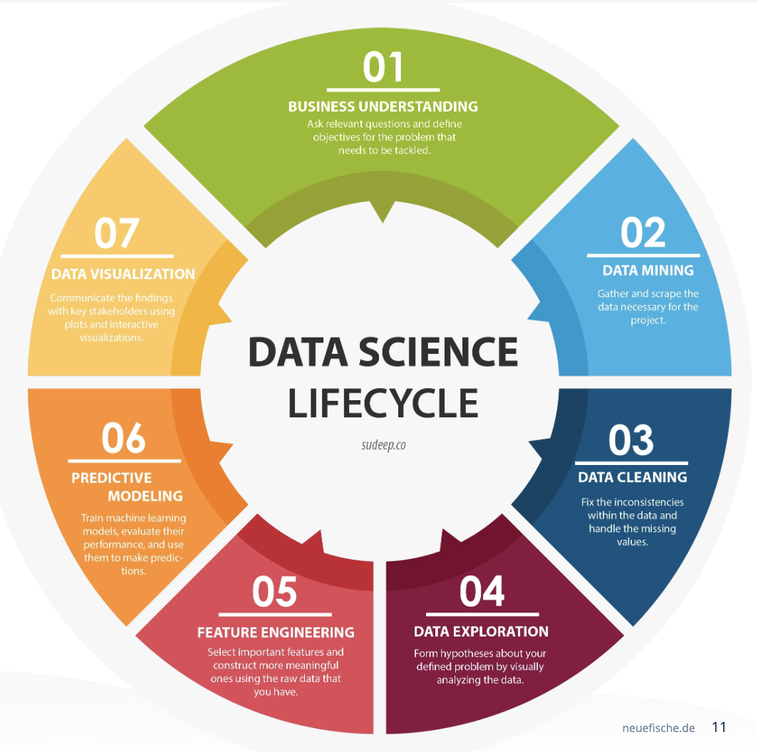

Slide 4
1. Overviewing data
find missing
fillna()
find outliners & deal with them
only bedrooms < 10 if the ratio was less than 3 to 1 bathroom

Slide 5
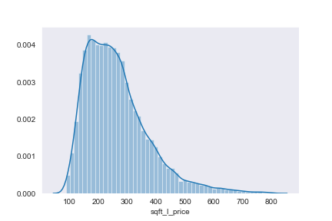
1. Overviewing data – adding feature
creating one new feature for analysis
price / sqft_living
price / sqft_living
Notes:
frequencie diagram

Slide 6
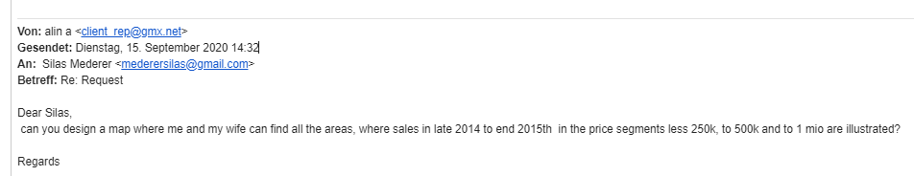
2. Client descriptions and request
Client status groups:
institutional developers and wealthy clients
high income families or couples
working class people
Request:
Where can I afford to buy a house in my price segment, based on previous sales?
We want a map!
Notes:
Now lets have a few words before we get overwhelmed.
You will see nearly the same map with different data. On the side will be a scale and there is title as well.
We will read the maps together I will guide you.

Slide 7
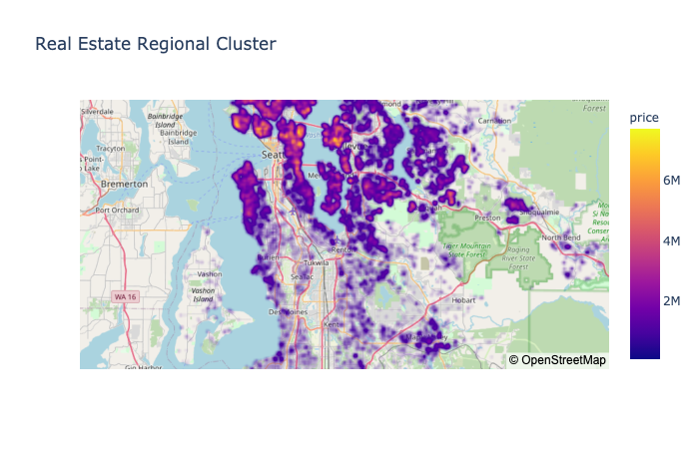
2. Client descriptions and request
Notes:
Now lets have a few words before we get overwhelmed.
You will see nearly the same map with different data. On the side will be a scale and there is title as well.

Slide 8
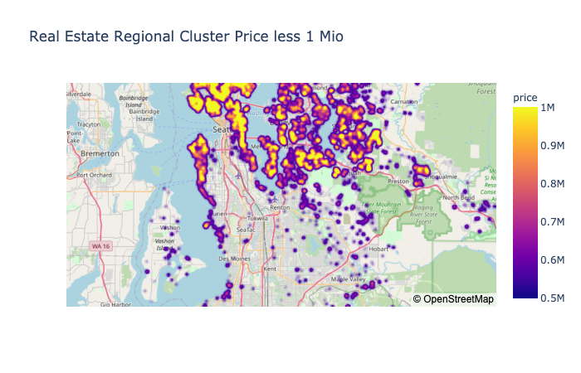
2. Client descriptions and request
Notes:
Now lets have a few words before we get overwhelmed.
You will see nearly the same map with different data. On the side will be a scale and there is title as well.

Slide 9
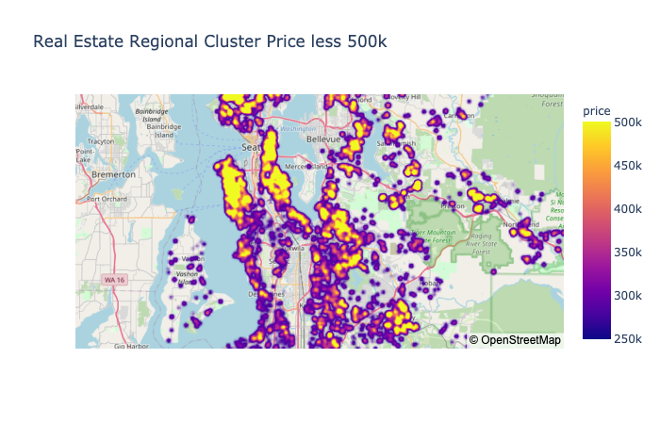
2. Client descriptions and request
Notes:
Now lets have a few words before we get overwhelmed.
You will see nearly the same map with different data. On the side will be a scale and there is title as well.

Slide 10
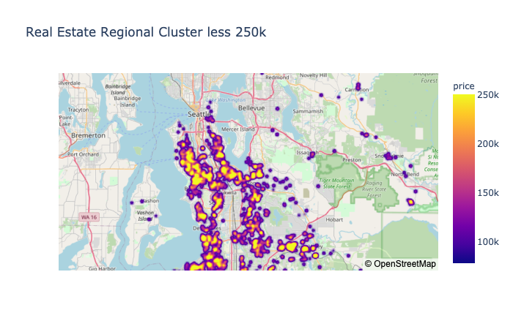
2. Client descriptions and request
Notes:
Now lets have a few words before we get overwhelmed.
You will see nearly the same map with different data. On the side will be a scale and there is title as well.

Slide 11
2. Client descriptions and request
The more you go to the south the cheaper it gets
Notes:
Well at least over all, there is no information about the size. It is just the price für one object.
Lets have a look on prices sqft

Slide 12
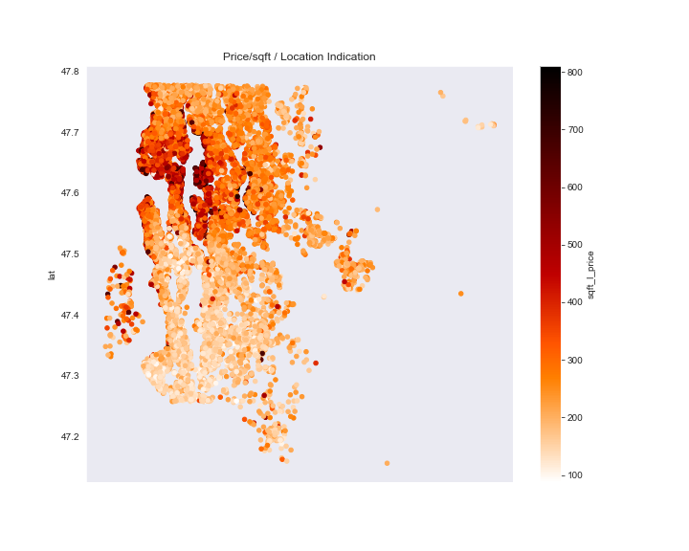
2. Client descriptions and request
Notes:
Now lets have a few words before we get overwhelmed.
You will see nearly the same map with different data. On the side will be a scale and there is title as well.

Slide 13
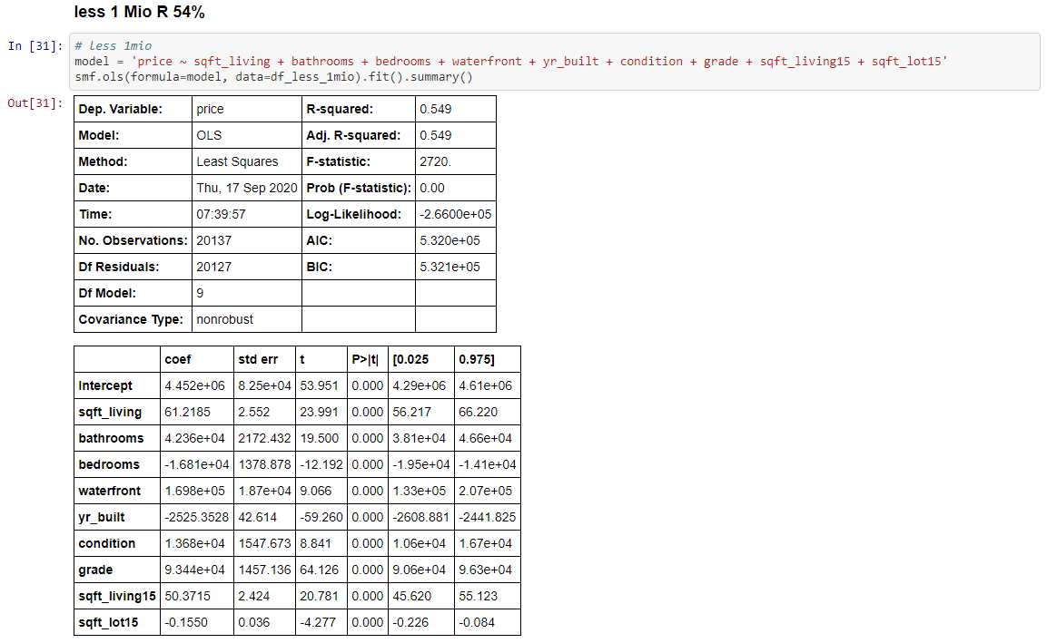

3. Regression Model
No bonus for this

Slide 14
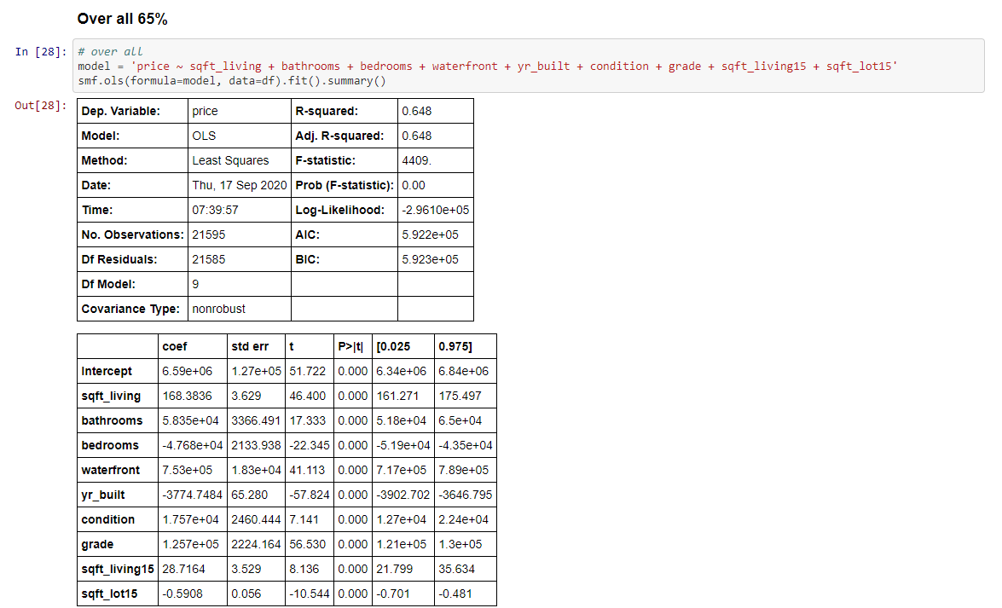
3. Regression Model
No bonus for this

Slide 15
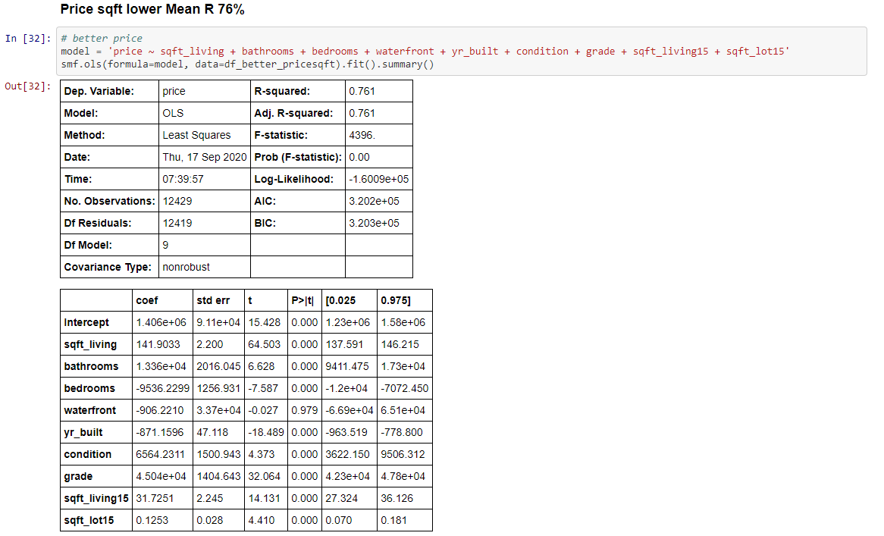

3. Regression Model
Getting better nine weeks to go
Notes:
So bad that I don´t even want to show them. You can have a look on GitHub or just enjoy the failure the mean squared errors are above 240k

Slide 16
4. Linear regression with bad results
=
5. Future projects

Slide 17
Thanks for your attention
any questions or critiques

Slide 18
special Thanks to Tjade, JJ, Silvia and Lars who supported me in the making

